Slide 1



BDA100 Final Project
Unlocking insights From global Superstore data (2015-18)
Course: Introduction to Data Science
Course Code: BDA100NAA
Group 2:
RISHI RAJ DAS, 165212234
LUKA LAZAREV, 143871242
DUY BAO KHANG NGUYEN, 185000239
01

Slide 2

Dataset
Brief introduction & goal
Retail dataset of a global superstore for 4 years. This dataset contains retail sales data and will be used to perform exploratory data analysis, linear regression, and time-series analysis to uncover business insights such as customer behavior, product performance, and regional sales trends.
The goal is to support decision-making in marketing, inventory planning, sales strategies, and improve profit margins.
Dataset characteristics
Number of instances (rows): 9,800
Number of variables (columns): 18
Numerical variables: Row ID, Postal Code, Sales, Profit.
Categorical variables: Order ID, Order Date, Ship Date, Ship Mode, Customer ID, Customer Name, Segment, Country, City, State, Region, Product ID, Category, Sub-Category, Product Name.
02

Slide 3


Categorical
variables
Frequency Tables
PIVOT CHART I – Top Cities by Sales Volume
PIVOT CHART II – Profit Breakdown by Region & Shipping Mode
PIVOT CHART III – Profitability by Product Sub-Category
03

Slide 4
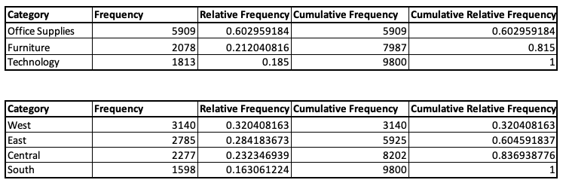

FREQUENCY
TABLES
Product Category Sales:
Office Supplies account for most sales (60.3%) & Technology represents (18.5%), the smallest share
Over 80% of sales come from Office Supplies and Furniture combined
Regional Sales Distribution
The West region leads with 32% of total sales & South region has the lowest sales share at 16.3%
60%+ of sales are concentrated in the West and East regions
04

Slide 5
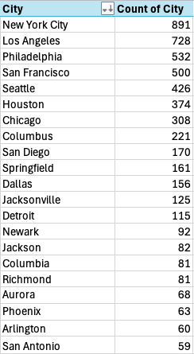
Top Cities by Sales Volume
PIVOT CHART I -
Key Highlights:
Over the 4-year period, New York City had the highest number of orders (891), followed by:
Los Angeles (728)
Philadelphia (532)
San Francisco (500)
Seattle (426)
The top 20 cities as shown in the picture collectively represent a strong concentration of customer activity
Implications:
Marketing efforts and stock planning can be prioritized in top-performing cities
High-order cities may benefit from regional promotions, faster delivery options, and localized inventory management
05

Slide 6
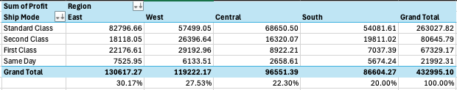
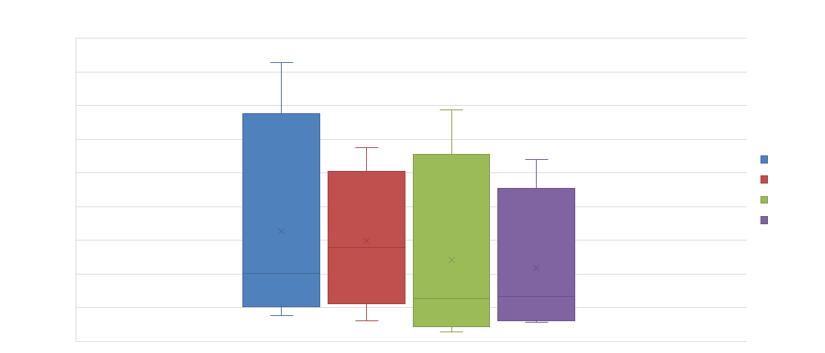
Profit Breakdown by Region & Shipping Mode
PIVOT CHART II -
Key Insights:
East Region leads in profitability, contributing over 30% of total profit (≈$130K), followed by:
West: 27.5%
Central: 22.3%
South: 20%
The most profitable shipping mode across all regions is Standard Class — generating over $263K, which is more than 60% of total profit
East & West benefit significantly from First Class and Second Class, suggesting premium shipping is more profitable in these areas
06

Slide 7
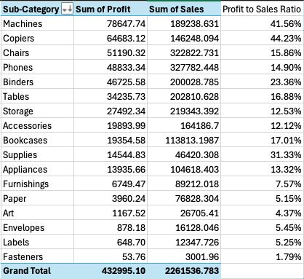
Profitability by Product Sub-Category
PIVOT CHART III -
Top Performers – High Profit & Efficiency:
Copiers (44.23% profit margin) and Machines (41.56% profit margin) lead in both profit and
profit-to-sales ratio
Though not top in sales, these items yield exceptional returns and are key drivers of overall profitability
High Sales, Moderate Profitability:
Phones, Chairs, and Binders generate significant sales volume but show lower profit margins:
Phones: 14.9%
Chairs: 15.86%
Binders: 23.36%
These are likely core products, but margins can be optimized
Balanced but Underperforming:
Storage, Accessories, and Furnishings have moderate sales but below-average profit ratios (7–13%)
These may benefit from pricing reviews or promotional repositioning
07

Slide 8


Numerical
variables
Sales Data Summary
Histogram I – Monthly Sales Distribution (2018)
Histogram II – Regional sales distribution
Box Plot – Yearly Sales
08

Slide 9
Sales data summary
Average (1,838.65)
Min - (2.03)
Max/Q4 - (28,106.72)
Average transaction is $1,838.65, suggesting a moderate transaction value overall.
The smallest recorded sale is $2.03,
The highest single sale is $28,106.72.
Q3 (2,382.22):
Q1 - (378.52)
Q2/Median (1,058.40)
75% of sales are under $2,382.22. The top 25% of transactions are notably high.
25% of all sales are less than $378.52.
Half of the sales fall below $1,058.40.
09

Slide 10
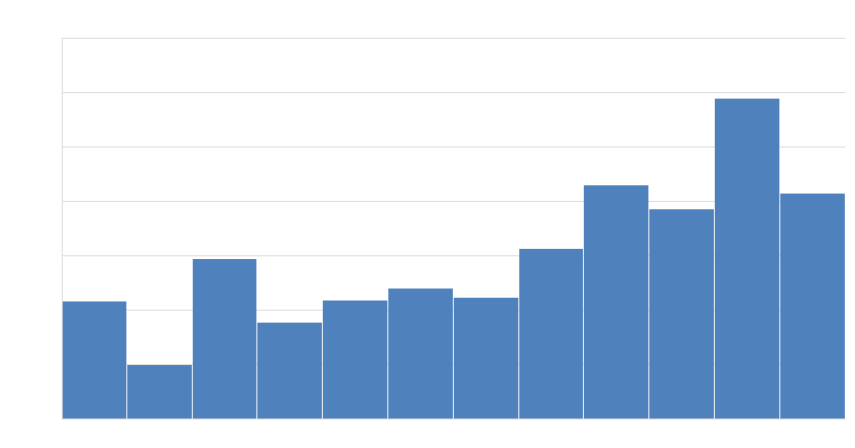
Monthly Sales Distribution (2018)
Histogram I -
Distribution: Left-skewed – most sales in lower-to-mid range, peak towards year-end.
Peak Months: Major spike in November ($117K) and December ($83K) due to holiday season.
Lowest Sales: February ($19K) – shortest month, low activity.
Trend: Gradual rise from August onward, highlighting strong Q4 performance.
Insight: Focus marketing & inventory efforts in late-year months.
10

Slide 11
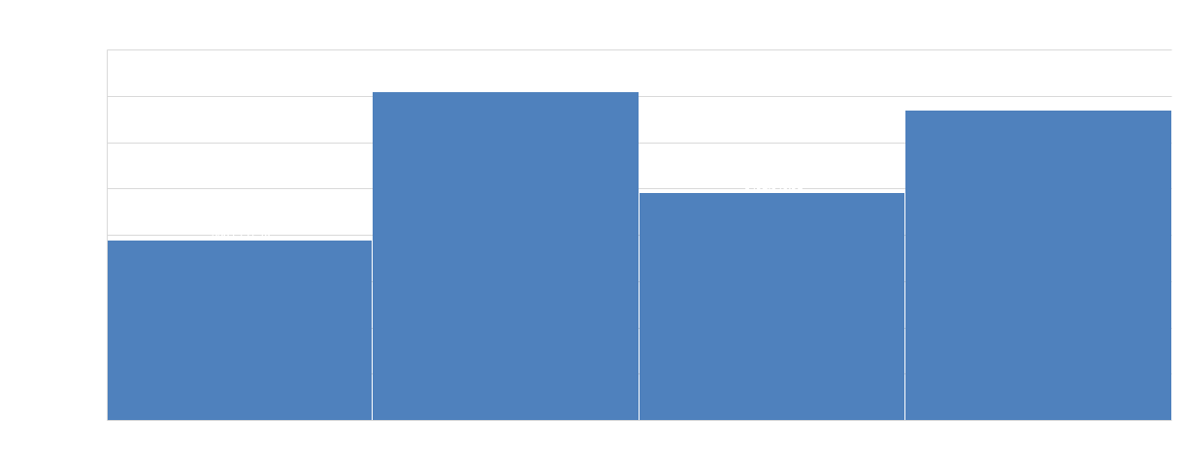
Regional sales distribution
Histogram II -
West region leads with the highest sales at $7.1M & East follows closely with $6.7M
Clear performance gap between top (West, East) and lower (Central, South) regions
Suggests stronger sales strategies or market potential in West and East & highlights opportunities for growth in South and Central regions
11

Slide 12
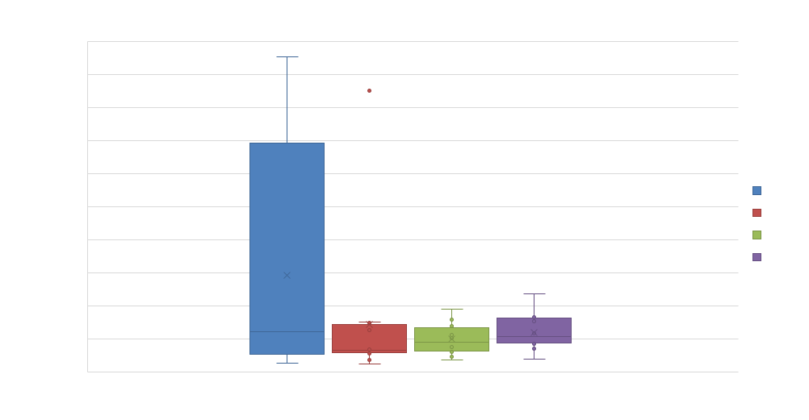
Box plot -
Yearly sales
Variability:
2015 & 2016 show very high variability due to extreme sales spikes in Feb–July (outliers).
2017 & 2018 have more consistent sales, showing lower variability.
Distribution:
2017 & 2018 distributions are more balanced with tighter IQRs.
2015 & 2016 are skewed due to abnormally high sales months.
Outliers:
Large outliers in 2015 (Feb–July) and 2016 (June) greatly inflate overall sales.
2018 has the least outliers, indicating more stable monthly performance.
12

Slide 13
Linear Regression
Summary
Strong Linear Relationship:
Correlation coefficient r = 0.8776 => strong positive correlation.
Regression Equation:
Profit = 0.5127 × Sales – 74.13
For every unit increase in sales, profit increases by ~0.51 units.
Model Performance (R² = 0.7702):
77.02% of profit variability is explained by sales.
Only 22.98% remains unexplained (due to other factors).
13

Slide 14
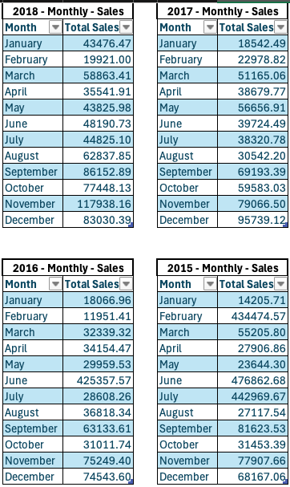
Time series analysis
Data Refinement Process
Started with a raw dataset containing every individual transaction made over 4 years, each with its exact date.
Cleaned and filtered the data to focus only on relevant fields, Order Date and Sales.
Grouped transactions by year and month to calculate the total monthly sales for each year (2015–2018).
Forecasting Methods Used
Used the refined monthly sales data to perform Time Series Forecasting using 4 key methods:
Naive Method – Uses the most recent value as the forecast.
Average Method – Forecasts based on the average of all past sales.
Moving Average – Smooths fluctuations using the average of recent periods.
Exponential Smoothing – Applies greater weight to recent data for more responsive forecasting.
14

Slide 15
Time series patterns
Naïve Method(Most Recent Value):
MAE: | 72136.82089
MSE: | 22238642421
MAPE: | 130.4079866
Average of Historical Data Method:
MAE: | 90711.52308
MSE: | 16199410354
MAPE: | 201.4157133
Moving Average Forcasting:
MAE: | 68705.82941
MSE: | 15262690090
MAPE: | 136.7869507
Exponential Smoothing Method:
MAE: | 67785.07493
MSE: | 14737648878
MAPE: | 121.6183795
Among all four methods, Exponential Smoothing performs the best based on lowest error values.
Why Exponential Smoothing is Better:
Lowest MAE (Mean Absolute Error): Gives more accurate predictions.
Lowest MSE (Mean Squared Error): Reduces large forecasting errors.
Lowest MAPE (Mean Absolute Percentage Error): More consistent and reliable percentage-based accuracy.
It adapts quickly to recent changes in data, making it more responsive and ideal for dynamic sales trends.
Using Exponential Smoothing, the predicted sales for Jan 2019 is:
$ 75,053.96
15

Slide 16

thank
you!
Dataset: https://www.kaggle.com/datasets/rohitsahoo/sales-forecasting/data
Worksheet: BDA100_Project_Final.xlsx
Note: access given to @seneca.ca emails
Report: BDA100_Project_Report.docx
Note: access given to @seneca.ca emails
Course: BDA100NAA, Introduction to Data Science
Instructor: Omid Aghababaei Tafreshi
Made By: Group 2
Members: RISHI RAJ DAS, 165212234
LUKA LAZAREV, 143871242
DUY BAO KHANG NGUYEN, 185000239
16

